Slide 1
Lecture 09
Network Layer (1/3)
Introduction, Datagram Networks and
IP Addressing
CSI3601504 - Jaringan Komunikasi Data
Fakultas Ilmu Komputer UI
3-<number>

Slide 2
Lecture 09: Roadmap
4. 1 Introduction
4.2 Datagram networks
4.3 IP: Internet Protocol
  Datagram format
  IPv4 addressing
  ICMP
  IPv6
Network Layer
4-<number>

Slide 3

















Network layer
transport segment from sending to receiving host
on sending side encapsulates segments into datagrams
on receiving side, delivers segments to transport layer
network layer protocols in every host, router
router examines header fields in all IP datagrams passing through it
application
transport
network
data link
physical
network
data link
physical
network
data link
physical
network
data link
physical
network
data link
physical
network
data link
physical
network
data link
physical
network
data link
physical
network
data link
physical
network
data link
physical
application
transport
network
data link
physical
network
data link
physical
network
data link
physical
Network Layer
4-<number>

Slide 4
Two key network-layer functions
forwarding: move packets from router’s input to appropriate router output
routing: determine route taken by packets from source to dest.
  routing algorithms
analogy:
routing: process of planning trip from source to dest
forwarding: process of getting through single interchange
Network Layer
4-<number>

Slide 5
Interplay between routing and forwarding
routing algorithm
routing algorithm determines
end-end-path through network
local forwarding table
forwarding table determines
local forwarding at this router
header value
output link
0100
0101
0111
1001
3
2
2
1
value in arriving
packet’s header
0111
1
3
2
Network Layer
4-<number>

Slide 6
Lecture 09: Roadmap
4. 1 Introduction
4.2 Datagram networks
4.3 IP: Internet Protocol
  Datagram format
  IPv4 addressing
  ICMP
  IPv6
Network Layer
4-<number>

Slide 7

Datagram networks
no call setup at network layer
routers: no state about end-to-end connections
  no network-level concept of “connection”
packets forwarded using destination host address
application
transport
network
data link
physical
application
transport
network
data link
physical
1. send datagrams
2. receive datagrams
Network Layer
4-<number>

Slide 8
Datagram forwarding table
4 billion IP addresses, so rather than list individual destination address
list range of addresses
(aggregate table entries)
routing algorithm
local forwarding table
dest address
output link
address-range 1
address-range 2
address-range 3
address-range 4
3
2
2
1
IP destination address in
arriving packet’s header
1
3
2
Network Layer
4-<number>

Slide 9
Datagram forwarding table
Destination Address Range
11001000 00010111 00010000 00000000
through
11001000 00010111 00010111 11111111
11001000 00010111 00011000 00000000
through
11001000 00010111 00011000 11111111
11001000 00010111 00011001 00000000
through
11001000 00010111 00011111 11111111
otherwise
Link Interface
0
1
2
3
Q: but what happens if ranges don’t divide up so nicely?
Network Layer
4-<number>

Slide 10
Longest prefix matching
longest prefix matching
when looking for forwarding table entry for given destination address, use longest address prefix that matches destination address.
Destination Address Range
11001000 00010111 00010*** *********
11001000 00010111 00011000 *********
11001000 00010111 00011*** *********
otherwise
Link interface
0
1
2
3
examples:
DA: 11001000 00010111 00010110 10100001
which interface?
DA: 11001000 00010111 00011000 10101010
which interface?
Network Layer
4-<number>

Slide 11
Lecture 09: Roadmap
4. 1 Introduction
4.2 Virtual circuit and datagram networks
4.4 IP: Internet Protocol
  Datagram format
  IPv4 addressing
  ICMP
  IPv6
Network Layer
4-<number>

Slide 12
The Internet network layer
host, router network layer functions:
transport layer: TCP, UDP
routing protocols
path selection
RIP, OSPF, BGP
IP protocol
addressing conventions
datagram format
packet handling conventions
network
layer
forwarding
table
ICMP protocol
error reporting
router “signaling”
link layer
physical layer
Network Layer
4-<number>

Slide 13
IP datagram format
IP protocol version
number
32 bits
total datagram
length (bytes)
header length
(bytes)
head.
len
type of
service
ver
length
for
fragmentation/
reassembly
“type” of data
flgs
fragment
offset
16-bit identifier
max number
remaining hops
(decremented at
each router)
time to
live
upper
layer
header
checksum
32 bit source IP address
upper layer protocol
to deliver payload to
32 bit destination IP address
options (if any)
e.g. timestamp,
record route
taken, specify
list of routers
to visit.
data
(variable length,
typically a TCP
or UDP segment)
how much overhead?
20 bytes of TCP
20 bytes of IP
= 40 bytes + app layer overhead
Network Layer
4-<number>

Slide 14
IP fragmentation, reassembly
network links have MTU (max.transfer size) - largest possible link-level frame
  different link types, different MTUs
large IP datagram divided (“fragmented”) within net
  one datagram becomes several datagrams
  “reassembled” only at final destination
  IP header bits used to identify, order related fragments
…
fragmentation:
in: one large datagram
out: 3 smaller datagrams
reassembly
…
Network Layer
4-<number>

Slide 15
IP fragmentation, reassembly
length
=4000
ID
=x
fragflag
=0
offset
=0
example:
4000 byte datagram
MTU = 1500 bytes
one large datagram becomes
several smaller datagrams
1480 bytes in
data field
length
=1500
ID
=x
fragflag
=1
offset
=0
offset =
1480/8
length
=1500
ID
=x
fragflag
=1
offset
=185
length
=1040
ID
=x
fragflag
=0
offset
=370
Network Layer
4-<number>

Slide 16
Lecture 09: Roadmap
4. 1 Introduction
4.2 Virtual circuit and datagram networks
4.4 IP: Internet Protocol
  Datagram format
  IPv4 addressing
  ICMP
  IPv6
Network Layer
4-<number>

Slide 17
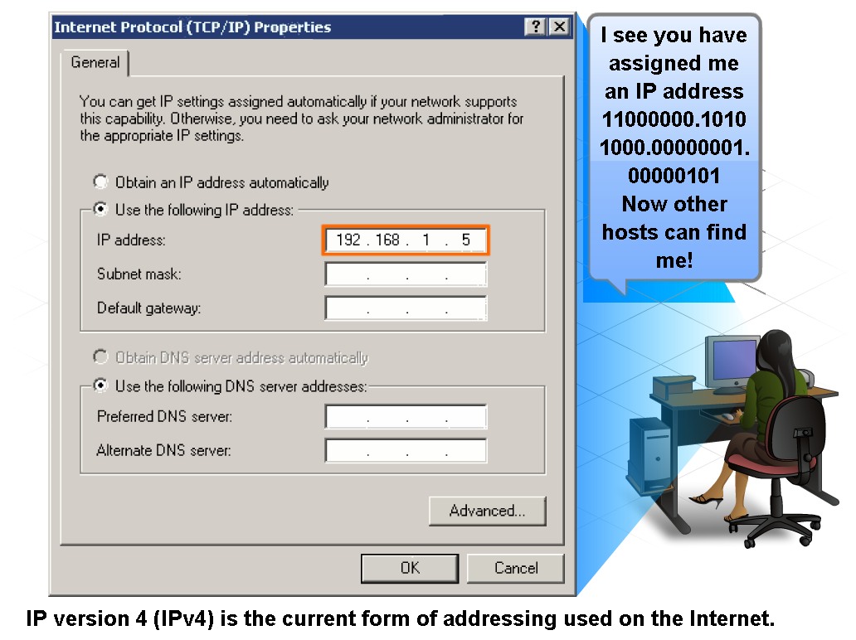
IP Addressing Structure
Describe the dotted decimal structure of a binary IP address and label its parts

Slide 18
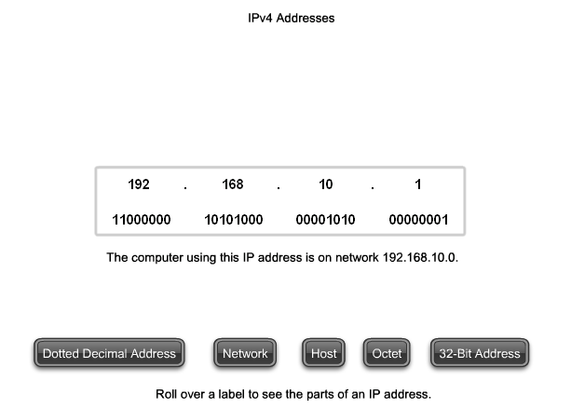
IP Addressing Structure
Describe the general role of 8-bit binary in network addressing and convert 8-bit binary to decimal

Slide 19
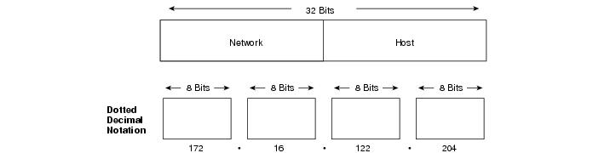
IP Addressing Structure
An IP address consists of 32 bits, grouped into four octets

Slide 20
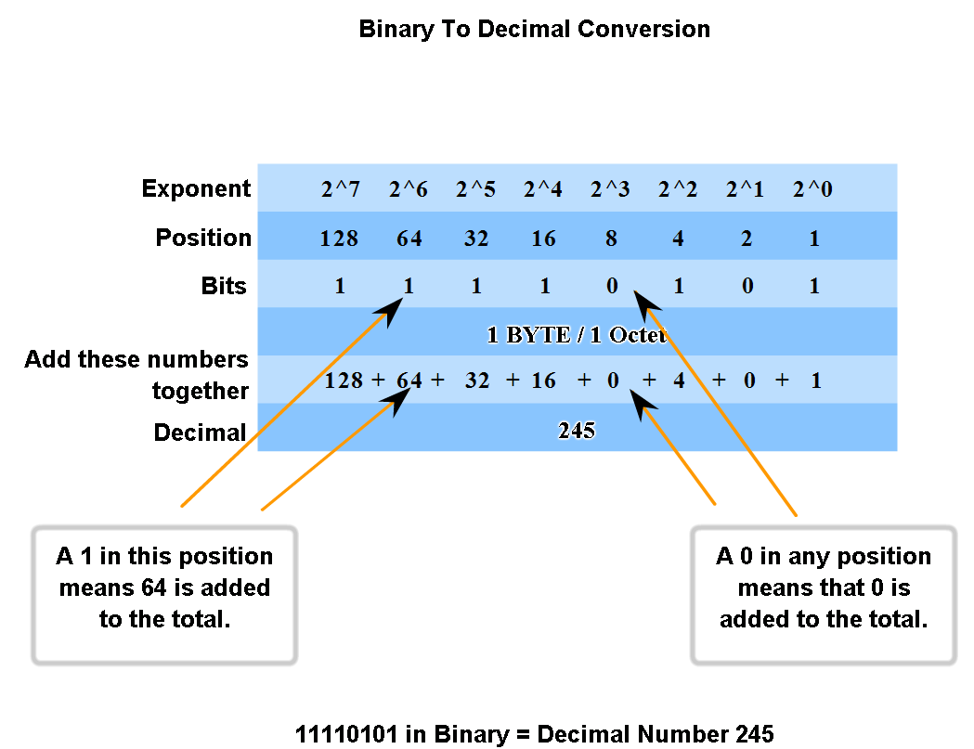
IP Addressing Structure
Practice converting 8-bit binary to decimal

Slide 21
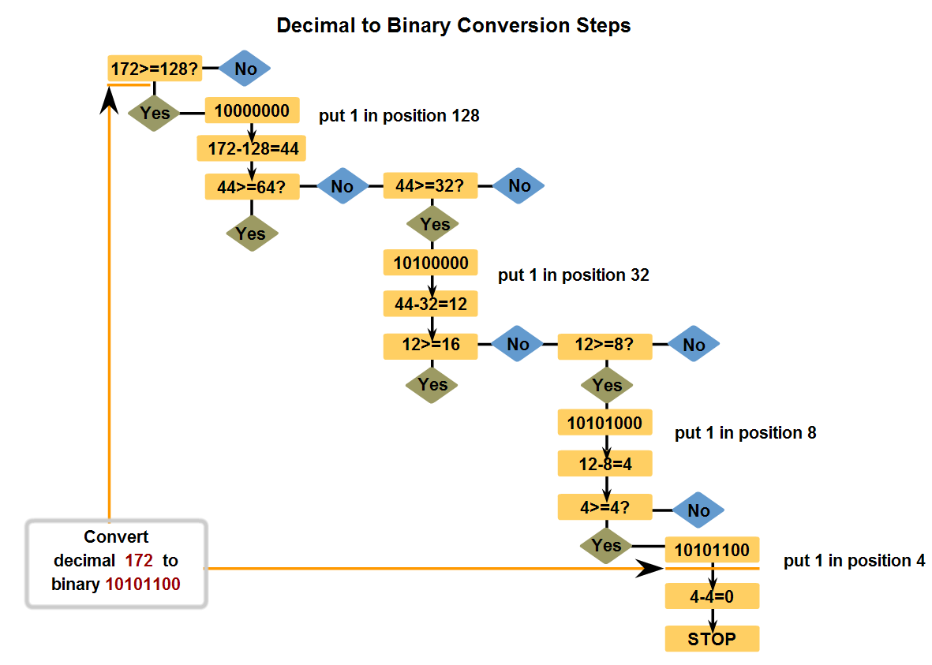
IP Addressing Structure
Convert decimal to 8-bit binary

Slide 22
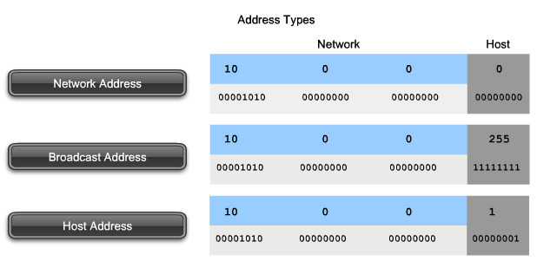
Classify and Define IPv4 Addresses
Name the three types of addresses in the network and describe the purpose of each type

Slide 23
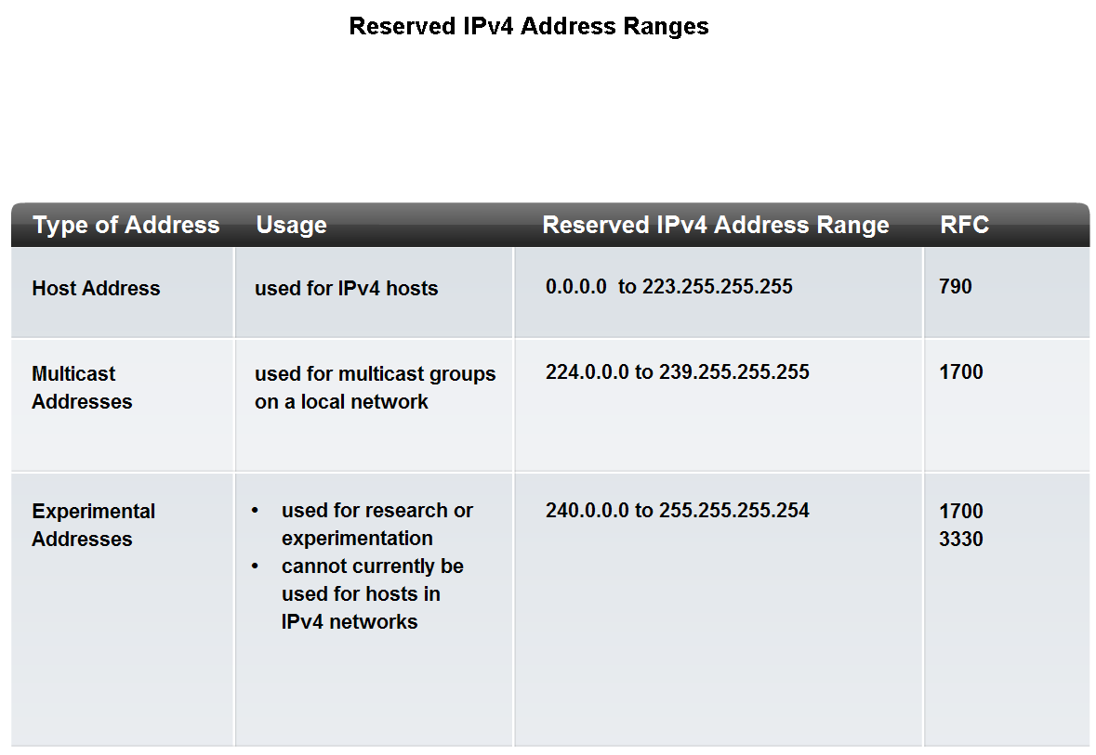
Classify and Define IPv4 Addresses
Identify the address ranges reserved for these special purposes in the IPv4 protocol

Slide 24
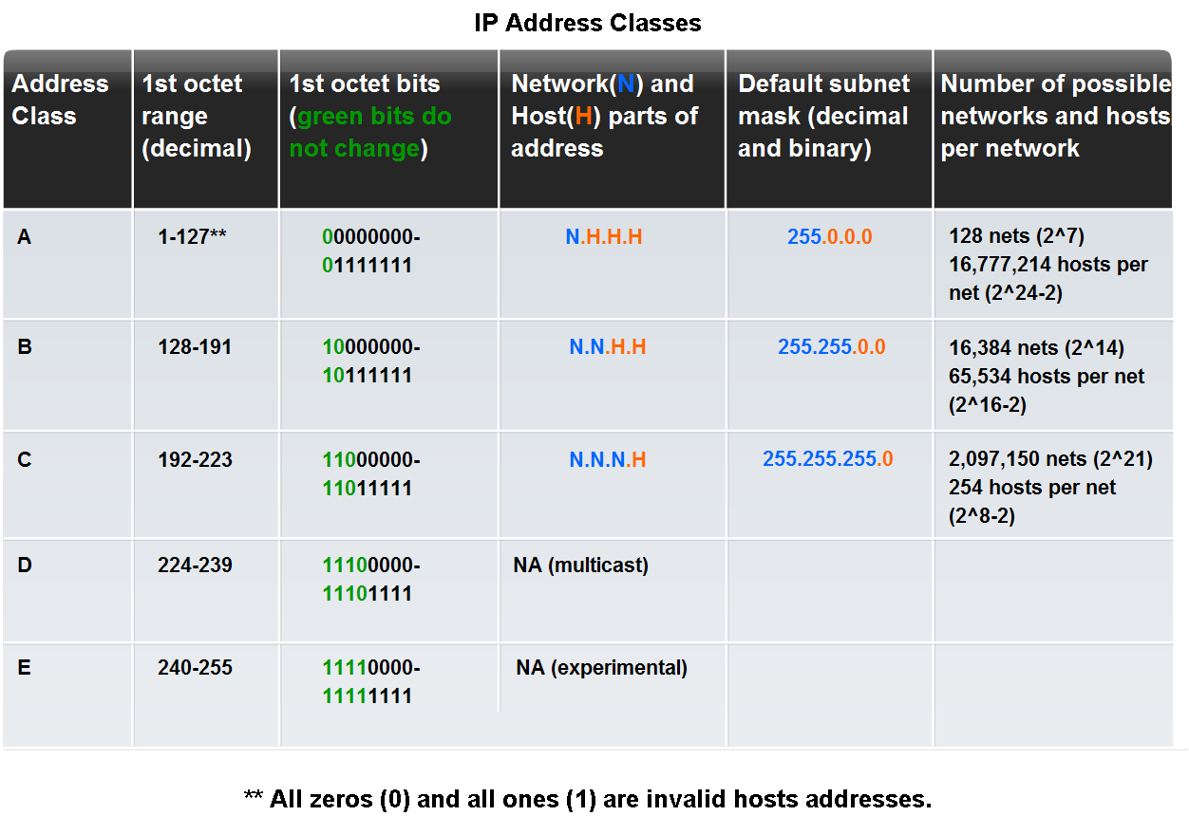
Classify and Define IPv4 Addresses
Identify the historic method for assigning addresses and the issues associated with the method

Slide 25
Subnetting
Used to partition the given address space into smaller, manageable sizes.
IP networks can be divided into smaller networks called subnetworks (or subnets).
Subnetting provides the network administrator with several benefits:
  Extra flexibility
  More efficient use of network addresses
  The capability to contain broadcast traffic (a broadcast will not cross a router).

Slide 26
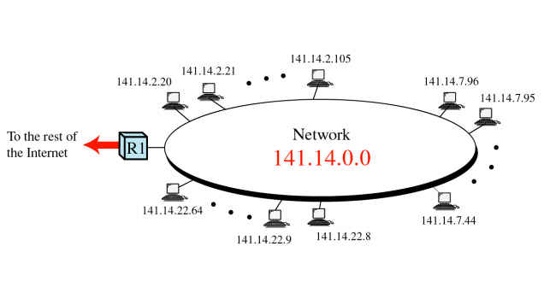
Without Subnetting
The entire network(141.14.0.0) is connected as one LAN

Slide 27
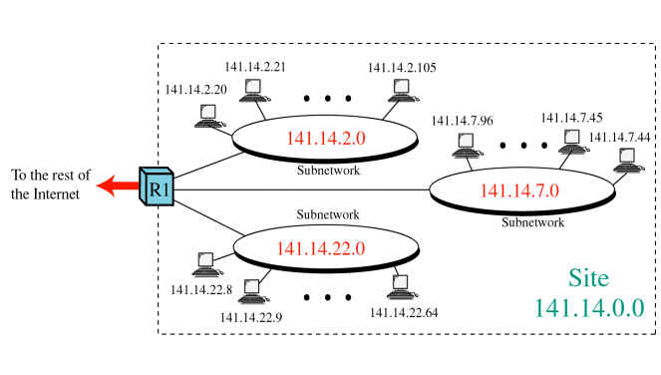
With subnetting
The LAN can be divided into manageable sizes

Slide 28
Types of Subnetting
There are two types of subnetting:
  Static Subnetting
  Variable Length Subnet Mask (VLSM)
Variable length is the more flexible of the two.

Slide 29
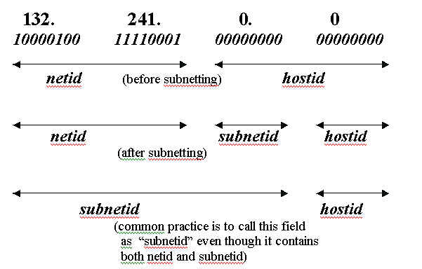
Static Subnetting
A portion of host address bits are used as subnetwork address bits
The "dividing line" between network address and host address parts is shifted variably to the right

Slide 30
Example
Given network of 204.17.5.0/24. Create two network subnet:
Before subnetting:
204.17.5.0 11001100.00010001.00000101.00000000
255.255.255.0 11111111.11111111.11111111.00000000
After subnetting with two subnet
204.17.5.0 11001100.00010001.00000101.00000000
255.255.255.128 11111111.11111111.11111111.10000000
204.17.5.128 11001100.00010001.00000101.10000000
255.255.255.128 11111111.11111111.11111111.10000000

Slide 31
Before and After Subnetting
Before Subnetting (204.17.5.0/24)
After Subnetting (two subnets)
Network Address (NA) | 4th Octet of NA (in binary) | Subnet Mask | First Host | Last Host
204.17.5.0 | x.x.x.00000000 | 255.255.255.0 | 204.17.5.1 | 204.17.5.254
Network Address (NA) | 4th Octet of NA (in binary) | Subnet Mask | First Host | Last Host
204.17.5.0 | x.x.x.00000000 | 255.255.255.128 | 204.17.5.1 | 204.17.5.126
204.17.5.128 | x.x.x.10000000 | 255.255.255.128 | 204.17.5.129 | 204.17.5.254

Slide 32
Before and After Subnetting
Before Subnetting (204.17.5.0/24)
After Subnetting (two subnets)
Network Address (NA) | Total Host (2^{n}-2) | First Host | Last Host | Broadcast
204.17.5.0/24 | 254 | 204.17.5.1 | 204.17.5.254 | 204.17.5.255
Network Address (NA) | Total Host (2^{n}-2) | First Host | Last Host | Broadcast
204.17.5.0 | 126 | 204.17.5.1 | 204.17.5.126 | 204.17.5.127
204.17.5.128 | 126 | 204.17.5.129 | 204.17.5.254 | 204.17.5.255

Slide 33
Subnet mask
A subnet is defined by applying the subnet mask to the IP address
if a bits is "on" (set to 1) in the subnet mask, then that equivalent bit in the address is interpreted as a network bit
if a bits is "off" (set to 0) in the subnet mask, then that equivalent bit in the address is interpreted as a host bit
Standard subnet masks for the 3 classes of addresses
· for a class A address - 255.0.0.0
· for a class B address - 255.255.0.0
· for a class C address - 255.255.255.0

Slide 34
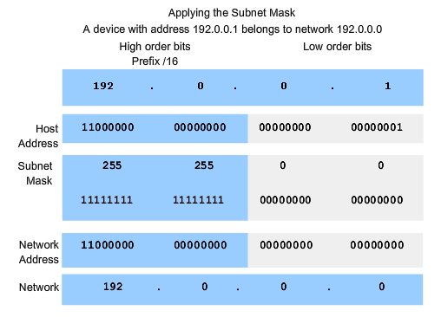
Determine the network portion of the host address and the role of the subnet mask
Use the subnet mask and ANDing process to extract the network address from the IP address

Slide 35
Given network address = 204.17.5.0/24, create 8 subnet!
Network Address (NA) | 4th Octet of NA (in binary) | Subnet Mask | First Host | Last Host
204.17.5.0 | x.x.x.00000000 | 255.255.255.224 | x.x.x.1 | x.x.x.30
204.17.5.32 | x.x.x.00100000 | 255.255.255.224 | x.x.x.33 | x.x.x.62
204.17.5.64 | x.x.x.01000000 | 255.255.255.224 | x.x.x.65 | x.x.x.94
204.17.5.96 | x.x.x.01100000 | 255.255.255.224 | x.x.x.97 | x.x.x.126
204.17.5.128 | x.x.x.10000000 | 255.255.255.224 | x.x.x.129 | x.x.x.158
204.17.5.160 | x.x.x.10100000 | 255.255.255.224 | x.x.x.161 | x.x.x.190
204.17.5.192 | x.x.x.11000000 | 255.255.255.224 | x.x.x.193 | x.x.x.222
204.17.5.224 | x.x.x.11100000 | 255.255.255.224 | x.x.x.225 | x.x.x.254
x.x.x = 204.17.5
Total Host = 2^{n} - 2 = 2⁵-2=30 Host
n = total bit for host id
Total Subnet = 2^{m} = 2³ = 8 Subnet
m = total bit for network id

Slide 36
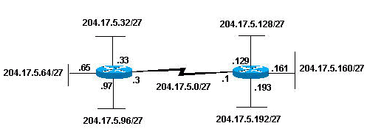
Illustration

Slide 37
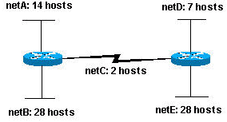
Without VLSM by Example
Given network address = 204.15.5.0/24. Subnet the network in order to create the network with the host requirements shown.

Slide 38
Answer
Based on the figure
  Total subnet based = 5 subnet
  Maximum number of host = 28 host
How many bits needed to create 5 subnet?
  1 bit ? Only 2 subnets created (2¹ subnet)
  2 bits? Only 4 subnets created (2² subnet)
  3 bits? 8 subnets created (2³ subnet). 3 subnet will be unused
Possible assigned subnets:
netA: 204.15.5.0/27 host address range 1 to 30
netB: 204.15.5.32/27 host address range 33 to 62
netC: 204.15.5.64/27 host address range 65 to 94
netD: 204.15.5.96/27 host address range 97 to 126
netE: 204.15.5.128/27 host address range 129 to 158

Slide 39
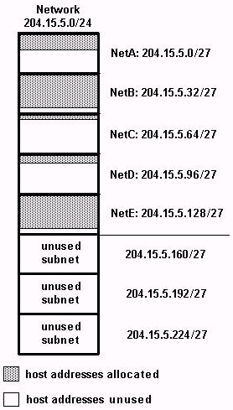
Variable Length Subnet Mask (VLSM)
Actual number of
Host needed :
Left figure shows the use of host address space on each subnet
NetA, NetC, and NetD have a lot of unused host address space
Variable Length Subnet Masks (VLSM) allows you to use different masks for each subnet, thereby using address space efficiently.
14
28
2
7
28

Slide 40
VLSM
Based on the previous example, develop a subnetting scheme with the use of VLSM
  netA: must support 14 hosts
  netB: must support 28 hosts
  netC: must support 2 hosts
  netD: must support 7 hosts
  netE: must support 28 host
Determine what mask allows the required number of hosts.

Slide 41
VLSM
netA: requires a /28 (255.255.255.240) mask to support 14 hosts
netB: requires a /27 (255.255.255.224) mask to support 28 hosts
netC: requires a /30 (255.255.255.252) mask to support 2 hosts
netD*: requires a /28 (255.255.255.240) mask to support 7 hosts
netE: requires a /27 (255.255.255.224) mask to support 28 hosts
* a /29 (255.255.255.248) would only allow 6 usable host addresses, therefore netD requires a /28 mask.

Slide 42
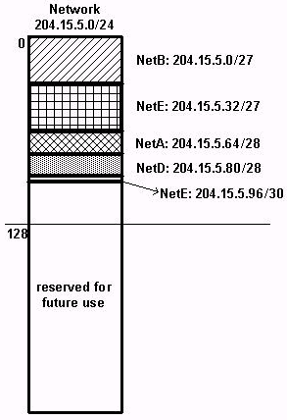
VLSM
The easiest way to assign the subnets is to assign the largest first. For example, you can assign in this manner:
netB: 204.15.5.0/27 host address range 1 to 30
netE: 204.15.5.32/27 host address range 33 to 62
netA: 204.15.5.64/28 host address range 65 to 78
netD: 204.15.5.80/28 host address range 81 to 94
netC: 204.15.5.96/30 host address range 97 to 98

Slide 43
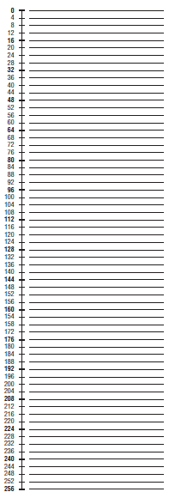
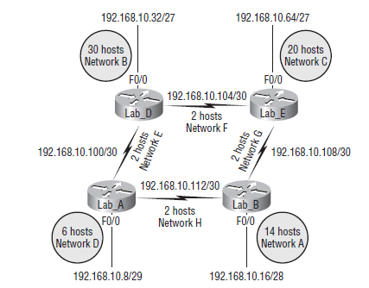
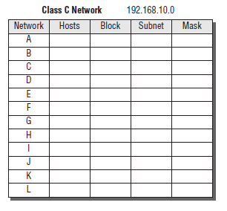
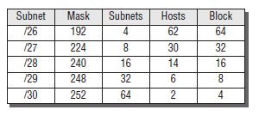
Latihan Soal VLSM

